Slide 1

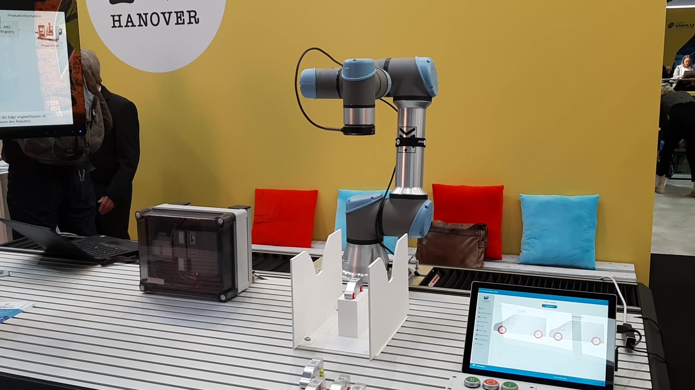
HM‘22/TddT‘22 demonstrator setup

Slide 2



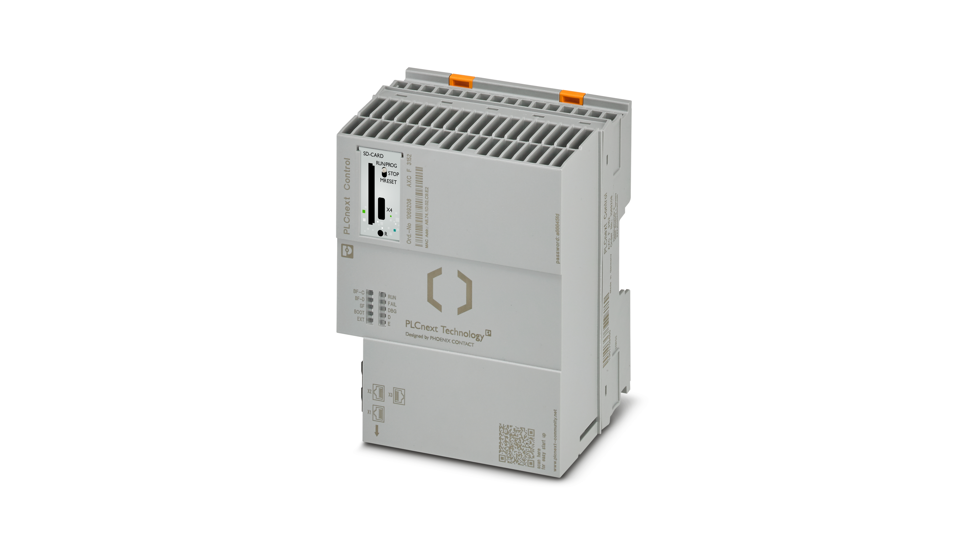
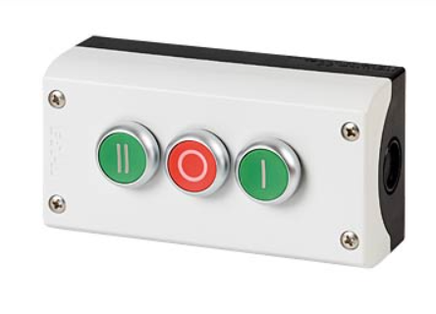
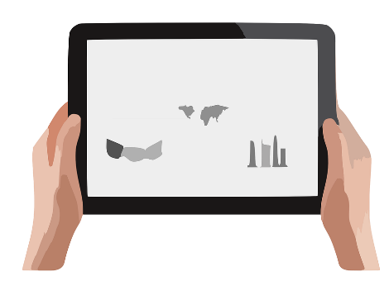


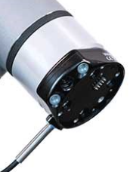
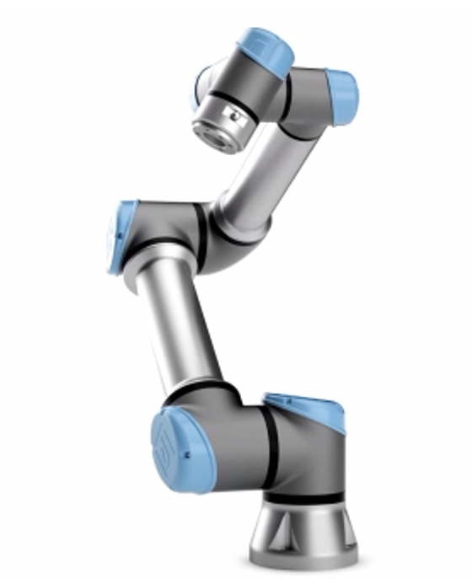
HM‘22/TddT‘22 demonstrator wiring
ProfiNet
MQTT
OPC UA
HTTP
Intel Atom
2G RAM
32G HDD
WiFi
Car-AAS
Elektr.
LAN
Tablet with Demo-UI
“Server”
LAN
LAN
App-AAS
LAN
ProfiNet
proprietary
HTTP (Cam)
USB

Slide 3
HM‘22/TddT‘22 service connections
OPC UA Connector
Trace*
Trace*
AI
Trace*
Trace*
Cam Source
Python AI
ActionDecider
App-AAS Service
Trace*
RapidMiner AI
Trace*
AAS Connector

